Slide 1
Section 11.4 The Comparison Tests
Lecture 1
Series Comparison

Slide 2

Section Homework Submission to Canvas
Preview of section​
Skim section, write short paragraph summary, list all important definitions / theorems / formulas.​
Notes on video lectures​
Include all details, worked examples, your own thoughts​
Worked examples from text​
Solutions to exercises​
Final reflection of section​
List of key takeaways to remember​

Slide 3
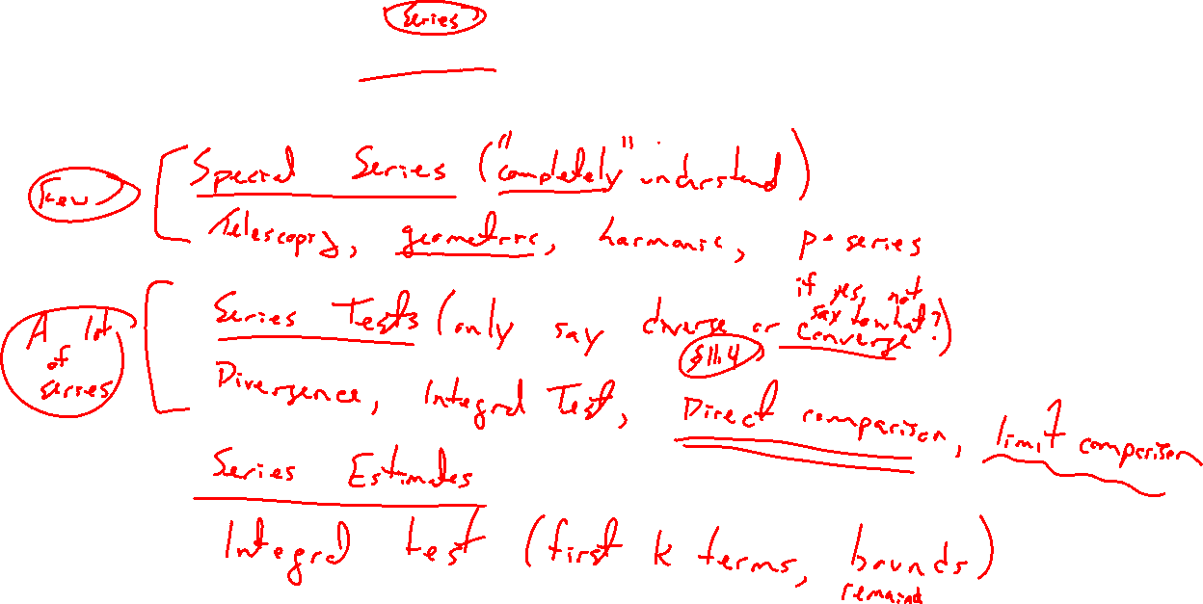
Summary of Results So Far
Notes:
Special series: geom, teles, harmonic
Tests: div, integral (add direct comparison / limit comparison)
Estimates: integral

Slide 4
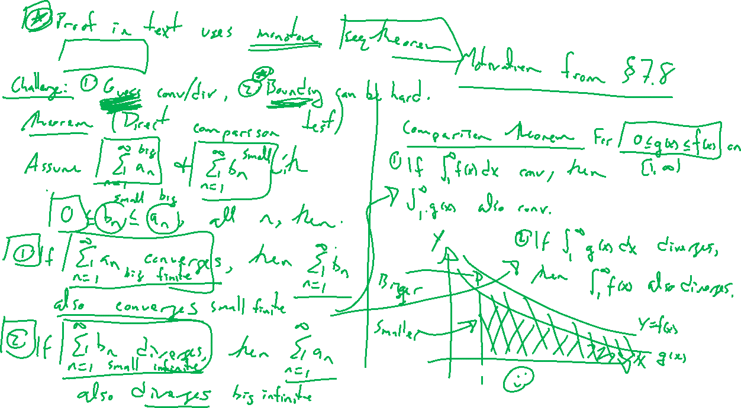
(Direct) Comparison Tests
Notes:
Reminder of integral comparison. Rate of decay was the focus.
Same version for series.
Careful theorem statement: Proof in text involves monotion seq theorem.
Difficulty: Bounding is not always easy. Will have an alternate version in lecture 2.

Slide 5
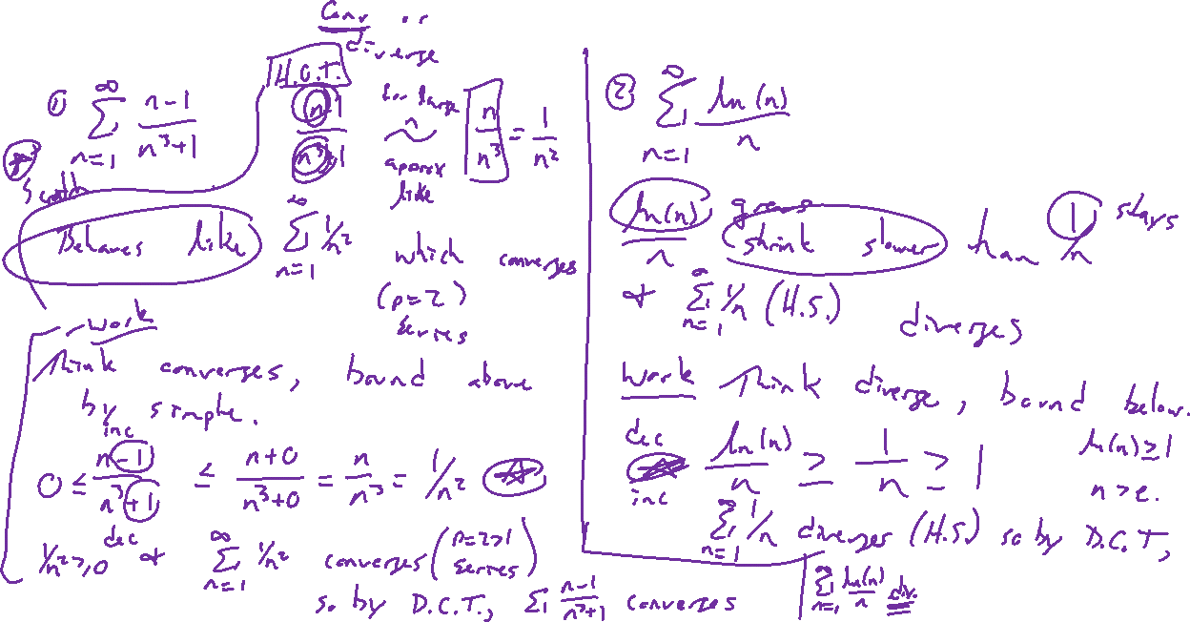
Examples
Notes:
(n-1)/(n^3+1), HOT says converge. Bound above. If signs differed bounding can be messy.
ln(n)/n, decays slower than harmonic so should diverge. Note this way easier than integral test.

Slide 6
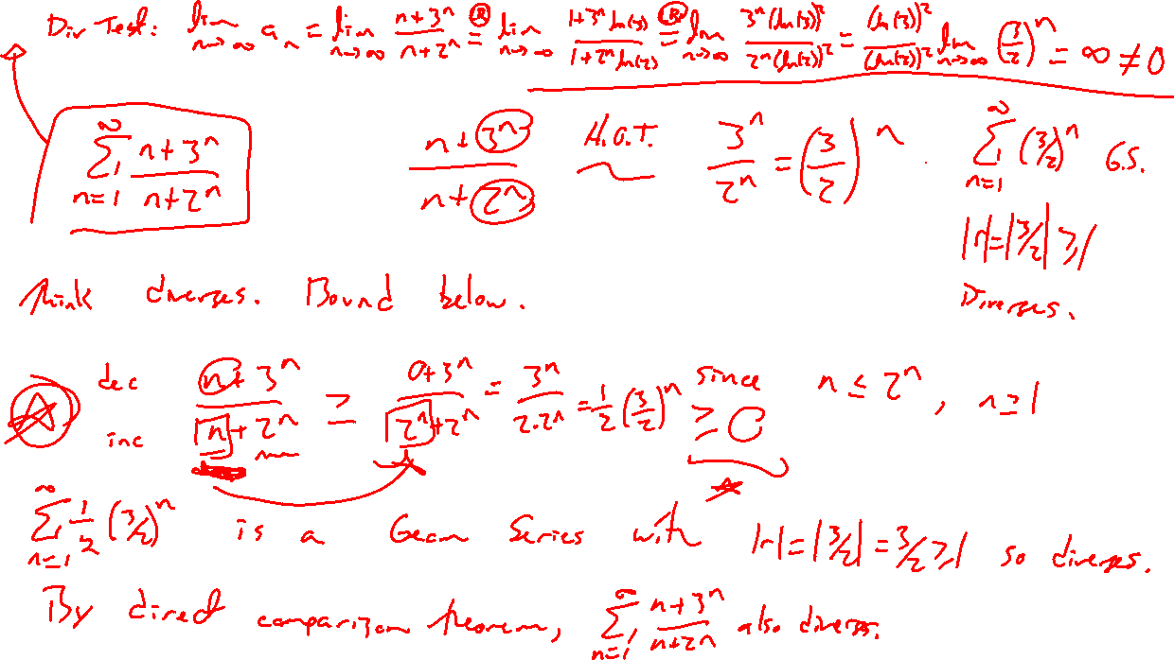
Example: Try on Own
Notes:
(n+3^n)/(n+2^n) need to bound below.
- can compare, also diverges by divergence test.

